Slide 1
Design of
Custom 3D Printed Submarine
Methodology and future plans brief
Durgansh Mishra
Sanket Khairnar

Slide 2
Basic ROV Designs
Most ROVs and AUVs used in science and industry today can be classified into torpedo shaped design and the non-torpedo shaped design.
Torpedo Shaped :
Less drag and faster speed
Useful for longer range and at low to moderate currents
Suitable for low-res surveys of larger areas
Hard to maneuver precisely over small areas
Need translational speed for full control of the vehicle
Generally have 6 degrees of freedom namely xyz translation, roll, pitch and yaw. (Current model has 4 degrees of freedom, translation in x & z and pitch & yaw)

Slide 3
Non-torpedo Shaped:
More drag and less speed compared to torpedo shaped design. Higher drags make them difficult to use in significant currents.
Useful for short range, high-res surveys.
Better suited for optical and bathymetric surveys.
Can be controlled more precisely in lower speeds and shorter ranges.
The multiple hull design is more stable in pitch and roll.
Our current design is torpedo based. In significant currents, like that of Brahmaputra river, it is more suitable but harder to control. Also it is less suited for optical surveys. We will be working on the current design i.e., torpedo, to make it easier to control and more suitable for optical surveys.
We have further planned of adding a Mechanical Arm to the ROV which may require further changes in the design. We will check the feasibility of single and double hull design for it.

Slide 4
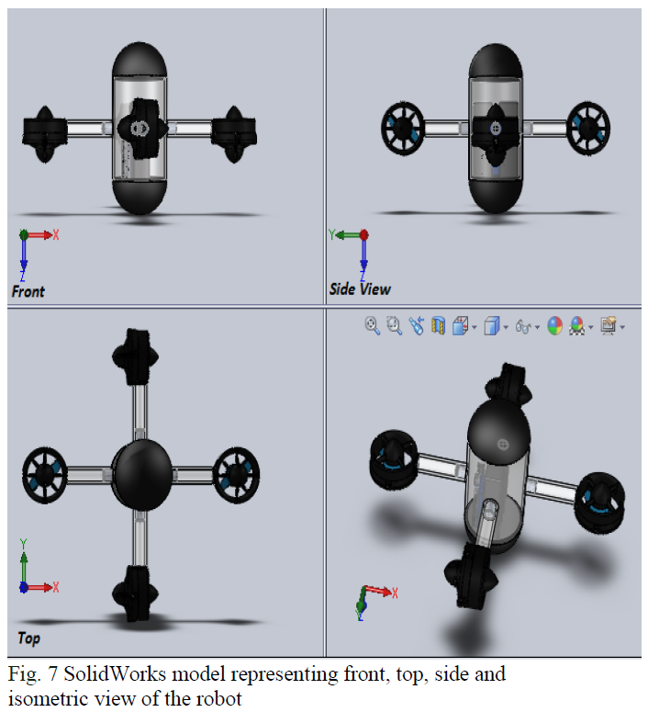
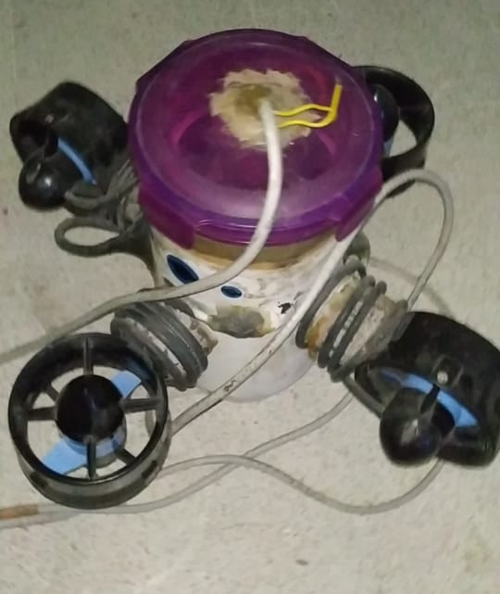
Current Design
Actual Model

Slide 5
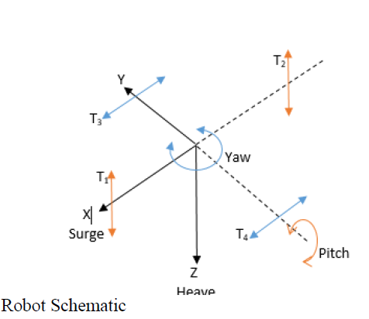
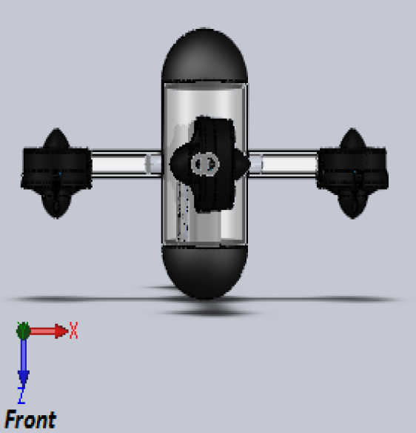
Motion
Translational motion in X (Surge)
Translational motion in Z
(Heave)

Slide 6
Problems with the Existing design :
Drag and stability
Due to vertical hull design the ROV experiences higher drag than conventional horizontal hull design while surging. We will have to test the stability in both orientations.
Position of thrusters
The thrusters are positioned closer to the hull than the CAD model, effect of which will have to be looked into.
Camera Position
With the current vertical orientation of the ROV, it is not feasible to add a camera as the thrusters block the view. Placing the camera at the bottom of the hull is not possible in the current design.
Upper end of the hull is flat which is different from the proposed model. It increases the drag while heaving as well as while surging.

Slide 7
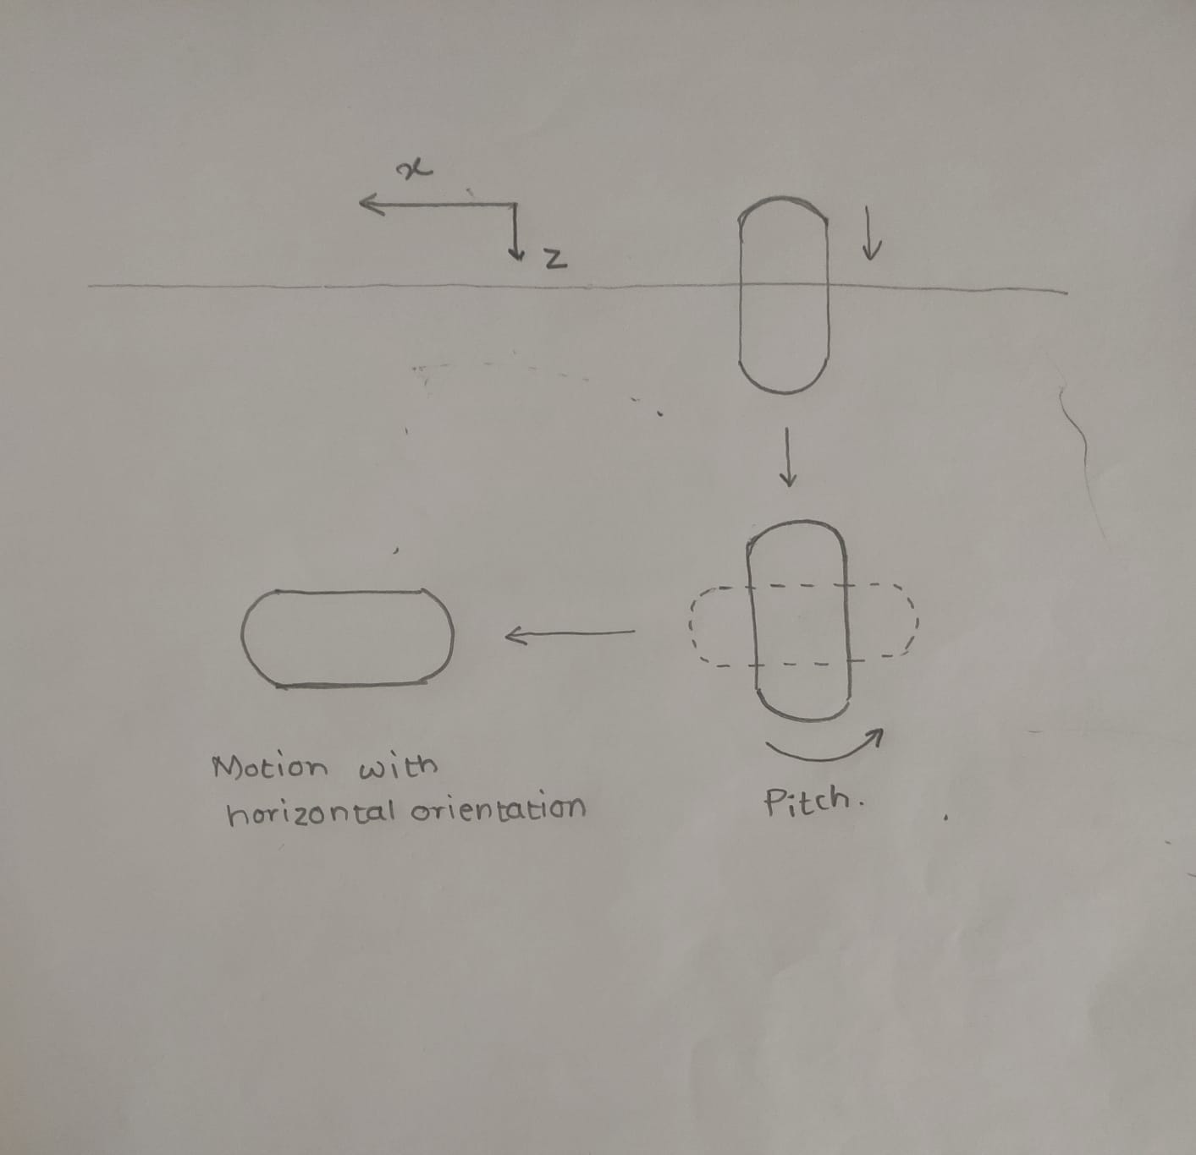
Proposed Solutions
To decrease the drag, one solutions can be to change the axis of our ROV after it submerges fully in the water to its desired depth. The horizontal orientation will be better suited for camera positioning and taking images. Problems with this idea is that we will have to consider the buoyant forces in both directions and have to make necessary changes.
Second option is to make the ROV horizontally oriented.
Hemispherical part needs to be added to the upper end to make the design more suitable for motion in water.
Proposed motion of the ROV

Slide 8
Design Additions
Frame Structure :
External frame structure can provide a platform for mounting additional features like sensors, camera, thrusters, mechanical arm. It also guards the hull from various obstacles. It can also increase stability. On the downside, it increases the weight and also the drag. More research and analysis needs to be done.
Mechanical Arm and Sample Collection Box :
Current design is not suitable for an addition of a mechanical arm. There should be an outer structure (like an external frame) to hold the sample box and the arm. The ROV should be able to compensate the disturbance caused by the movement of the arm.
Multiple Hull Design :
Multiple hull design is suitable for mechanical arm addition. It’s more stable and easy to maneuver.
Rotatable Thrusters :
Thrusters can change their orientation according to the direction of motion. This way we can minimise the number of thrusters or increase the thrust. But we will have to check its feasibility

Slide 9
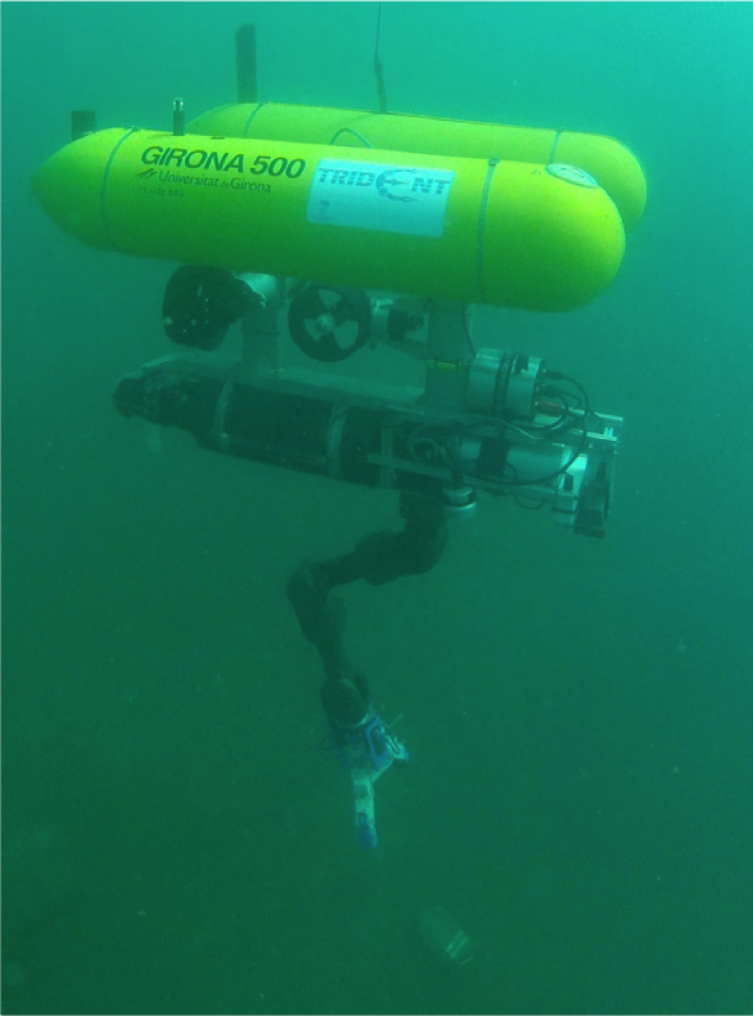
Mechanical Arm position in multiple hull design

Slide 10
Methodology
Literature Review :
According to the existing problems, relevant literature is to be studied, to verify our proposed solutions as well as to search for existing solutions or brainstorm some new approach.
For additional designs as mentioned previously, we have collected some papers on existing designs.
Theoretical Testing :
Testing of the feasibility of the proposed solutions and additional designs with the help of literature review and simulations.
Practical Testing :
Based on the theoretical testing we will choose the most appropriate solutions and practically test them. We will keep iterating on them until the optimal solution is found.

Slide 11
References
Vikrant P. Shah, “Design Considerations for Engineering Autonomous Underwater Vehicles”, The University of Texas at Austin, 2005
Avilash Sahoo et al, “Design of a Compact ROV for River Exploration”, IIT Guwahati, 2017
J. Singh, D. Gandhi, M. Sanghani, P. S. Robi and S. K. Dwivedy, "Design and development of underwater robot," 2015 International Conference on Robotics, Automation, Control and Embedded Systems (RACE), 2015
P. Ridao et al, “Intervention AUVs: The next challenge”, Annual Reviews in Control, 2015
Avilash Sahoo et al, “Advancements in the field of autonomous underwater vehicle”, IIT Guwahati, 2019
Harry Bohm, Steven W. Moore, and Vickie Jensen “Underwater Robotics – Science Design and Fabrication”
Jebelli A, Yagoub C and Dhillon S, “Design and Implementation of an Autonomous Underwater Vehicle (AUV) with PTFE”, University of Ottawa, Ottawa, Canada

